Slide 1
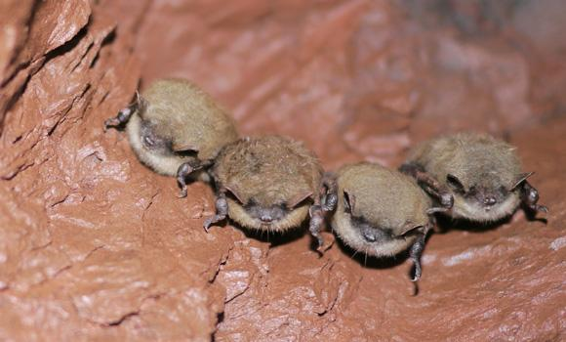

Bat Echolocation Detection
Bety Rostandy (brostandy)
Hadi Soufi (HadiSoufi)
Kevin Keomalaythong (kkeomalaythong)
Thien Le (InsertGithubUsernameHere)
Yang Peng (yangp18)
CSC 505 | 11.02.2018
Progress Report 3
Notes:
everyone

Slide 2
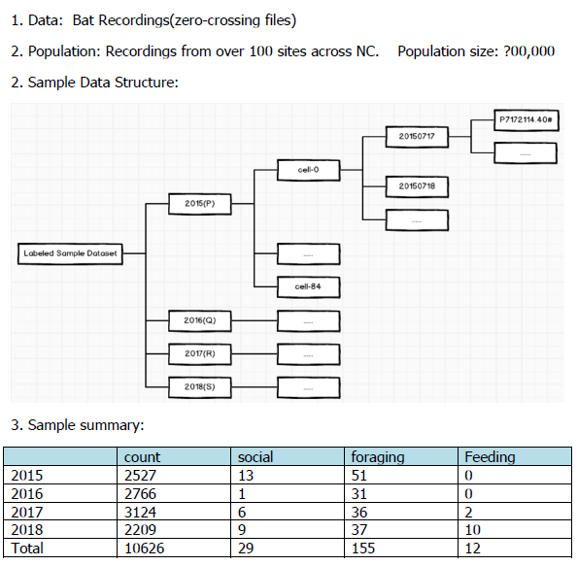
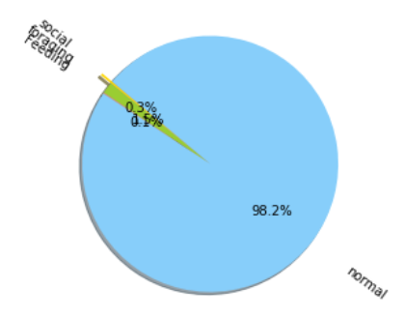
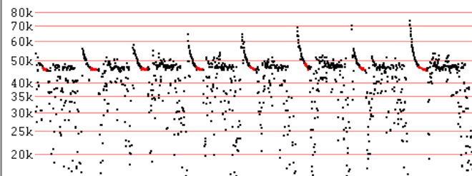
What data do we have?
Notes:
librosa data visualization package
Task by Member
Progress made towards the task.
If background research - describe it.
If coding - show outcomes.

Slide 3
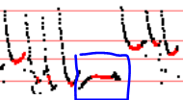
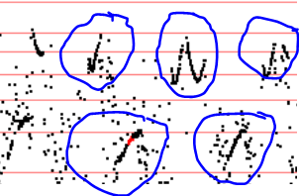
How does the bio-specialist label zc file?
Empirical Rule: If a zero-crossing contains at least one abnormal call(pulse), for example social call, then the zc file will be labeled as “social”.
e.g. Social labeled zc file:
Notes:
librosa data visualization package
Task by Member
Progress made towards the task.
If background research - describe it.
If coding - show outcomes.

Slide 4
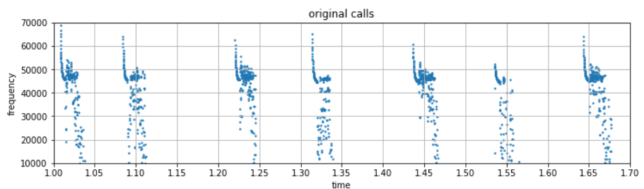
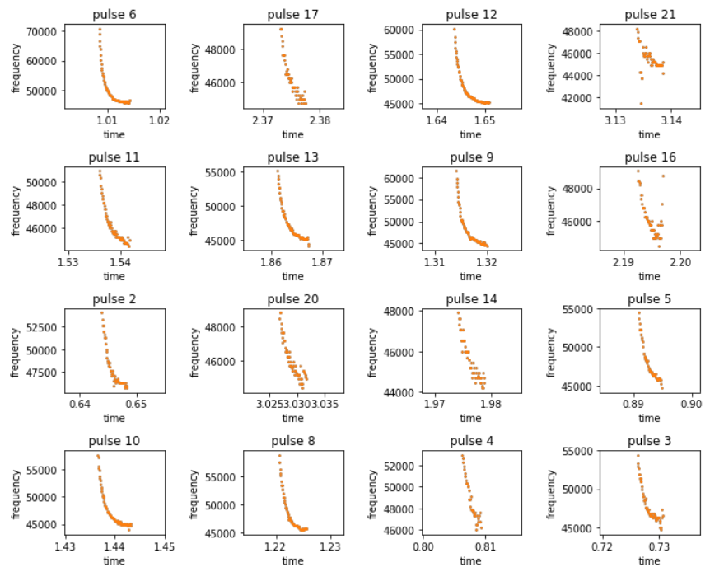
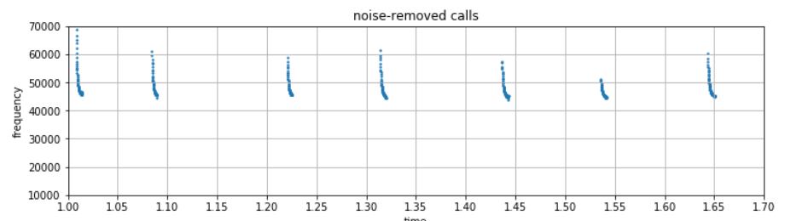
Progress - Yang P
Improved noise removal method by controlling average dy for each pulse.
Generalized valid calls visualization for multiple clustering.
Notes:
librosa data visualization package
Task by Member
Progress made towards the task.
If background research - describe it.
If coding - show outcomes.

Slide 5
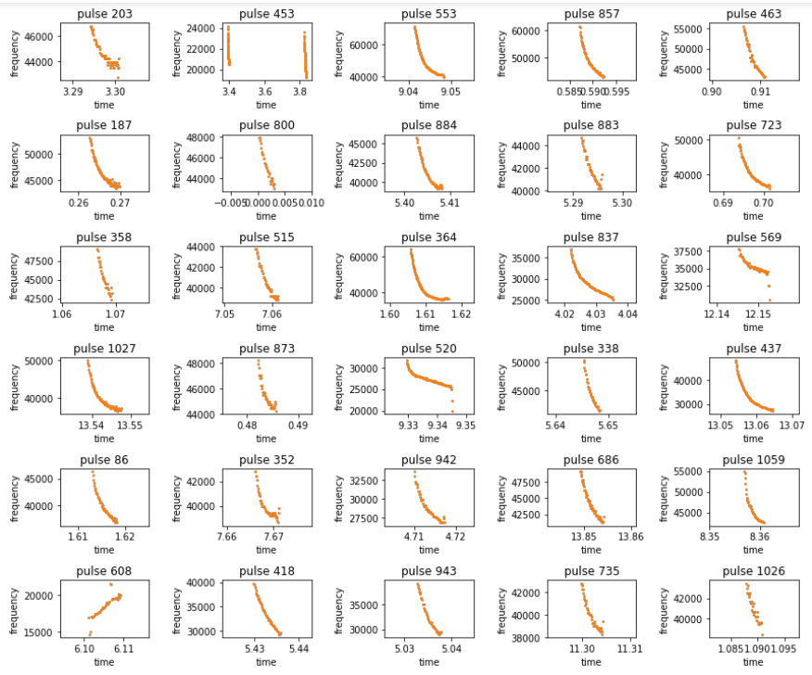
Progress - Yang P
Bulk import and processing from a directory and return all the noise-removed calls:
Ex:
\\2018\\cell-75\\20180715\\
124 zero-crossing files
Extracted 1096 valid calls
Notes:
librosa data visualization package
Task by Member
Progress made towards the task.
If background research - describe it.
If coding - show outcomes.

Slide 6
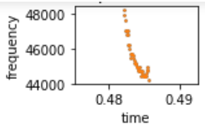
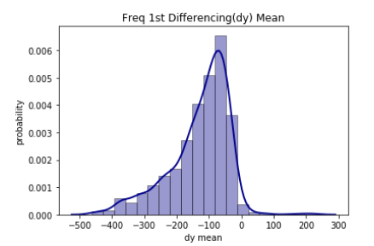
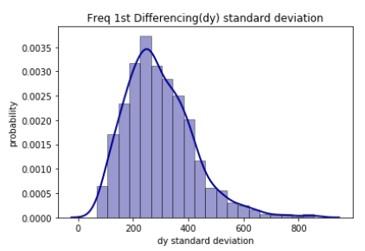
Progress - Yang P
Statistical Analysis for valid calls got from bulk processing:
For a dot in a valid call: x-axis---time(s), y-axis---frequency(kHz)
In order to detect the call trend, use dy = First differencing of frequency
Notes:
librosa data visualization package
Task by Member
Progress made towards the task.
If background research - describe it.
If coding - show outcomes.

Slide 7
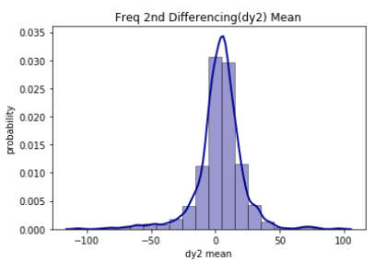
Progress - Yang P
In order to detect the curvature, use dy2= Second differencing of frequency
Notes:
librosa data visualization package
Task by Member
Progress made towards the task.
If background research - describe it.
If coding - show outcomes.

Slide 8
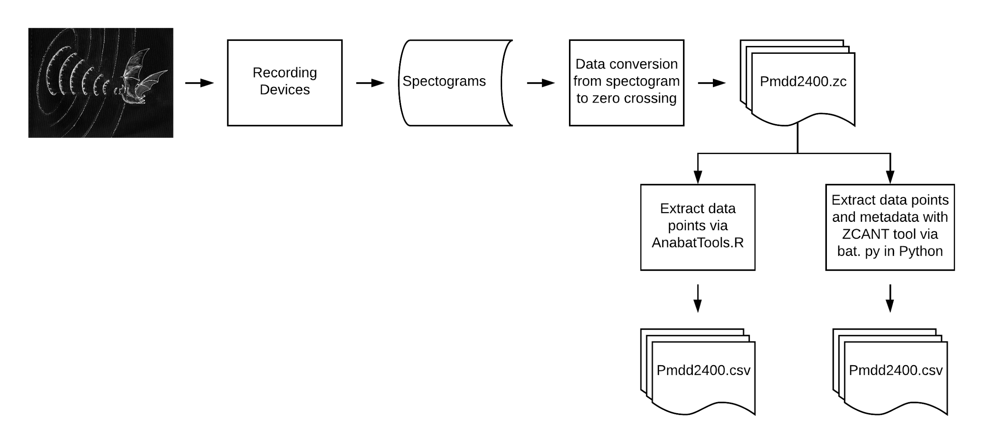
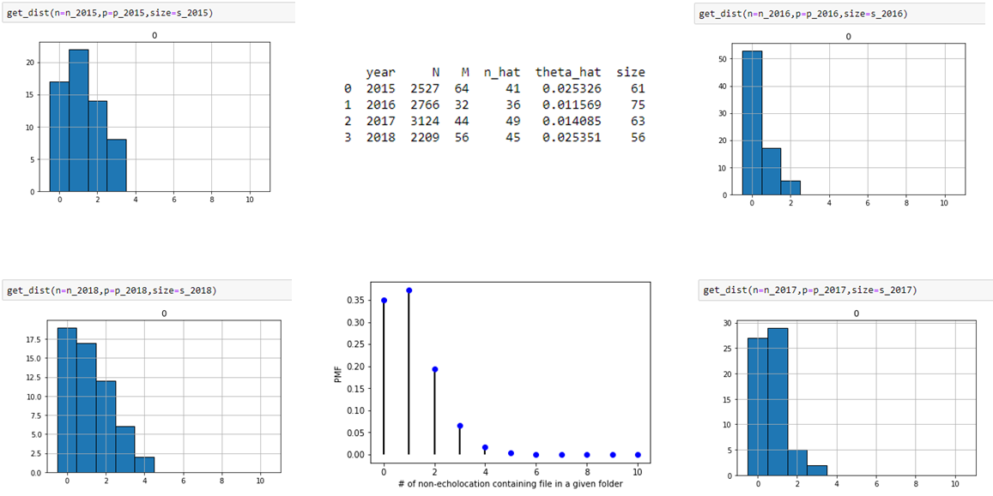
Multiprocessing Progress- Bety

Slide 9
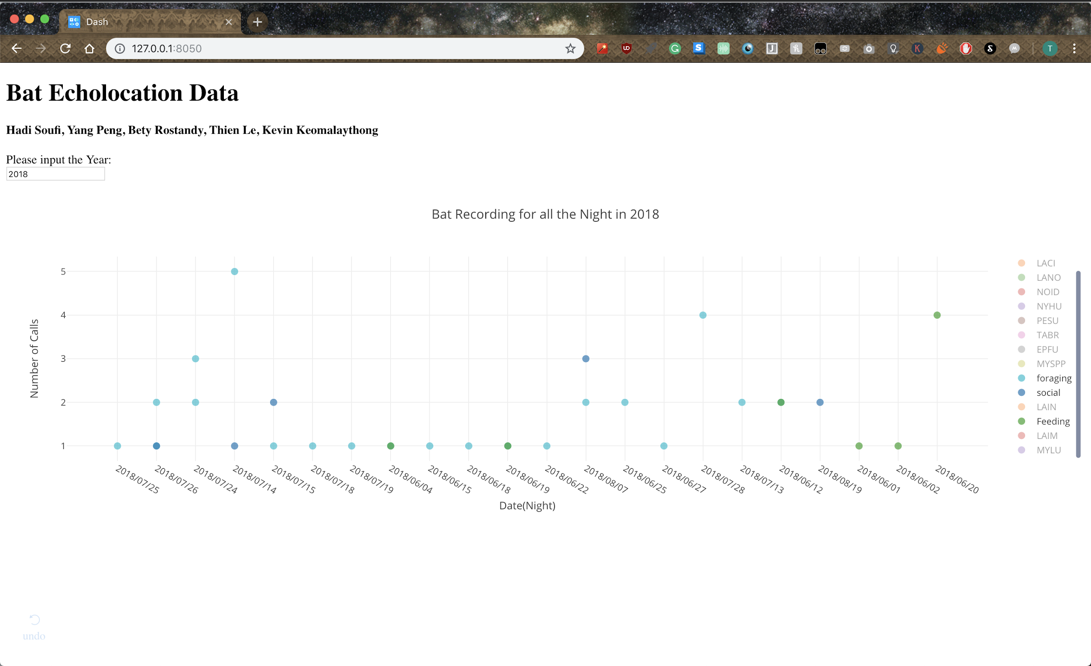
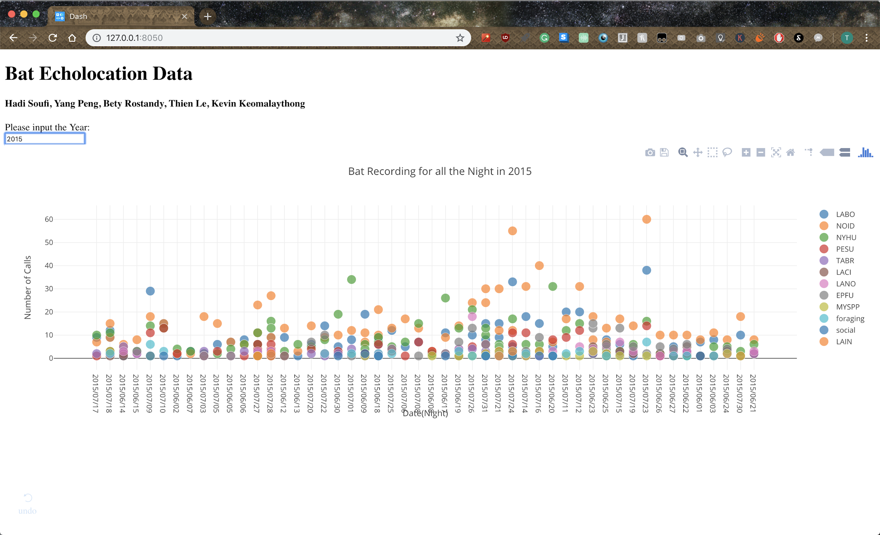
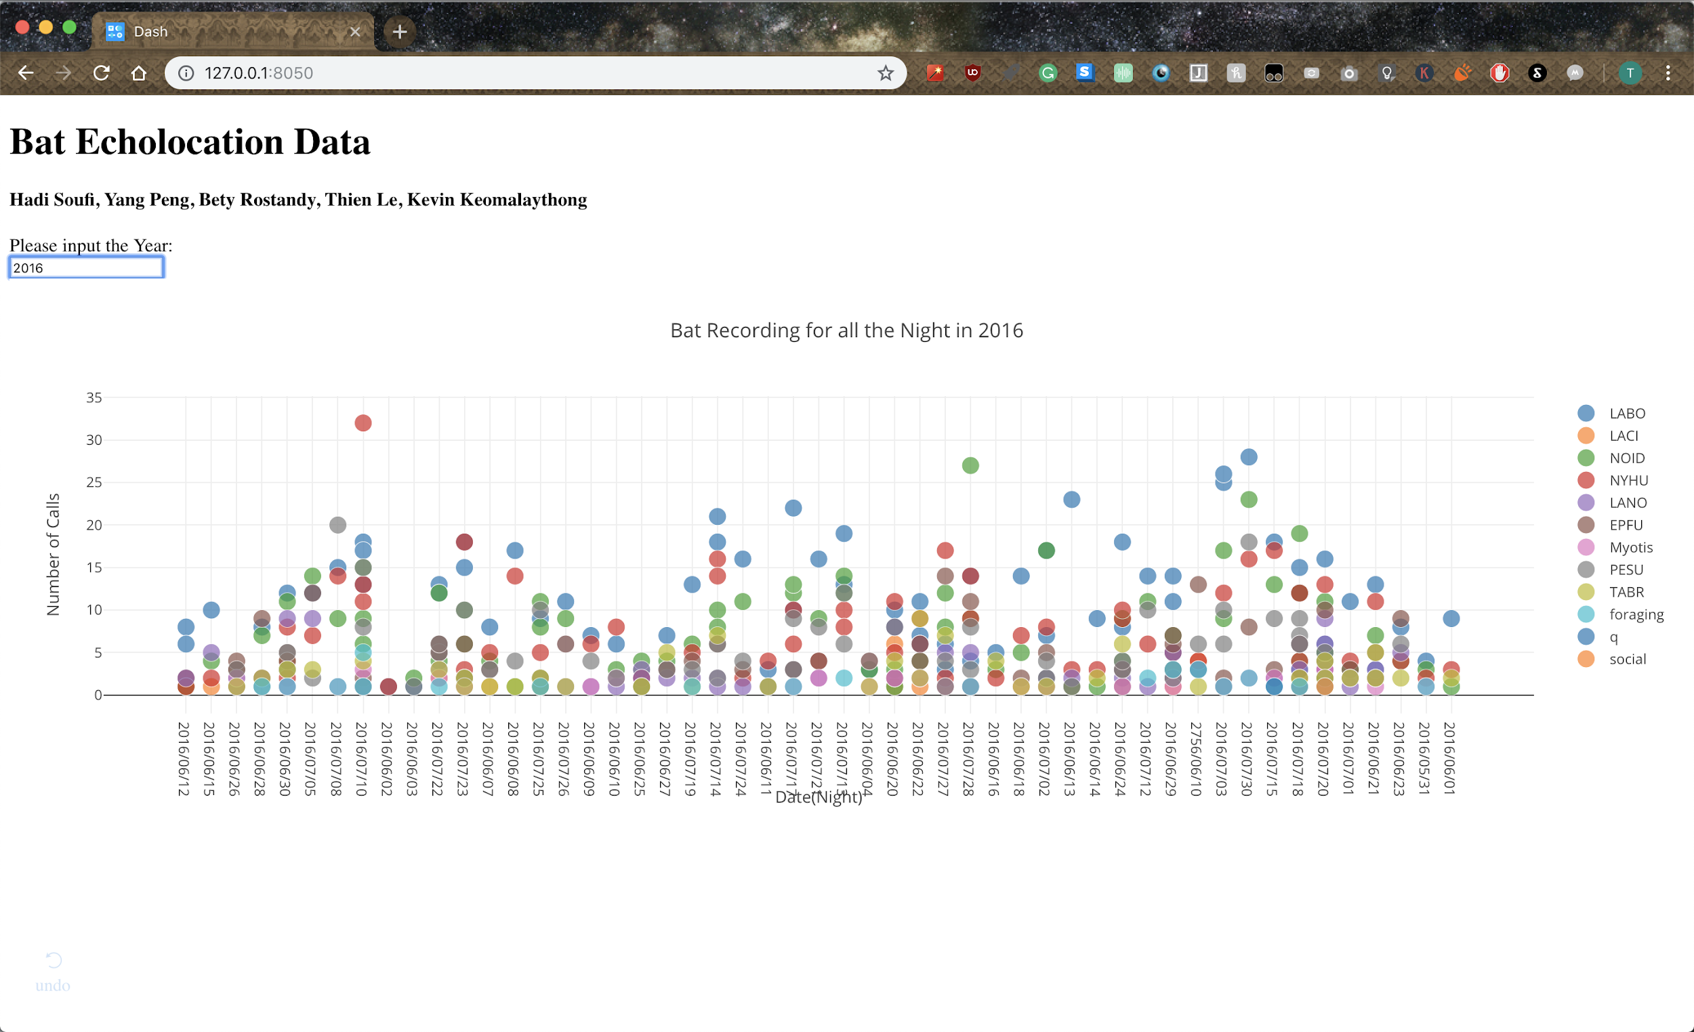
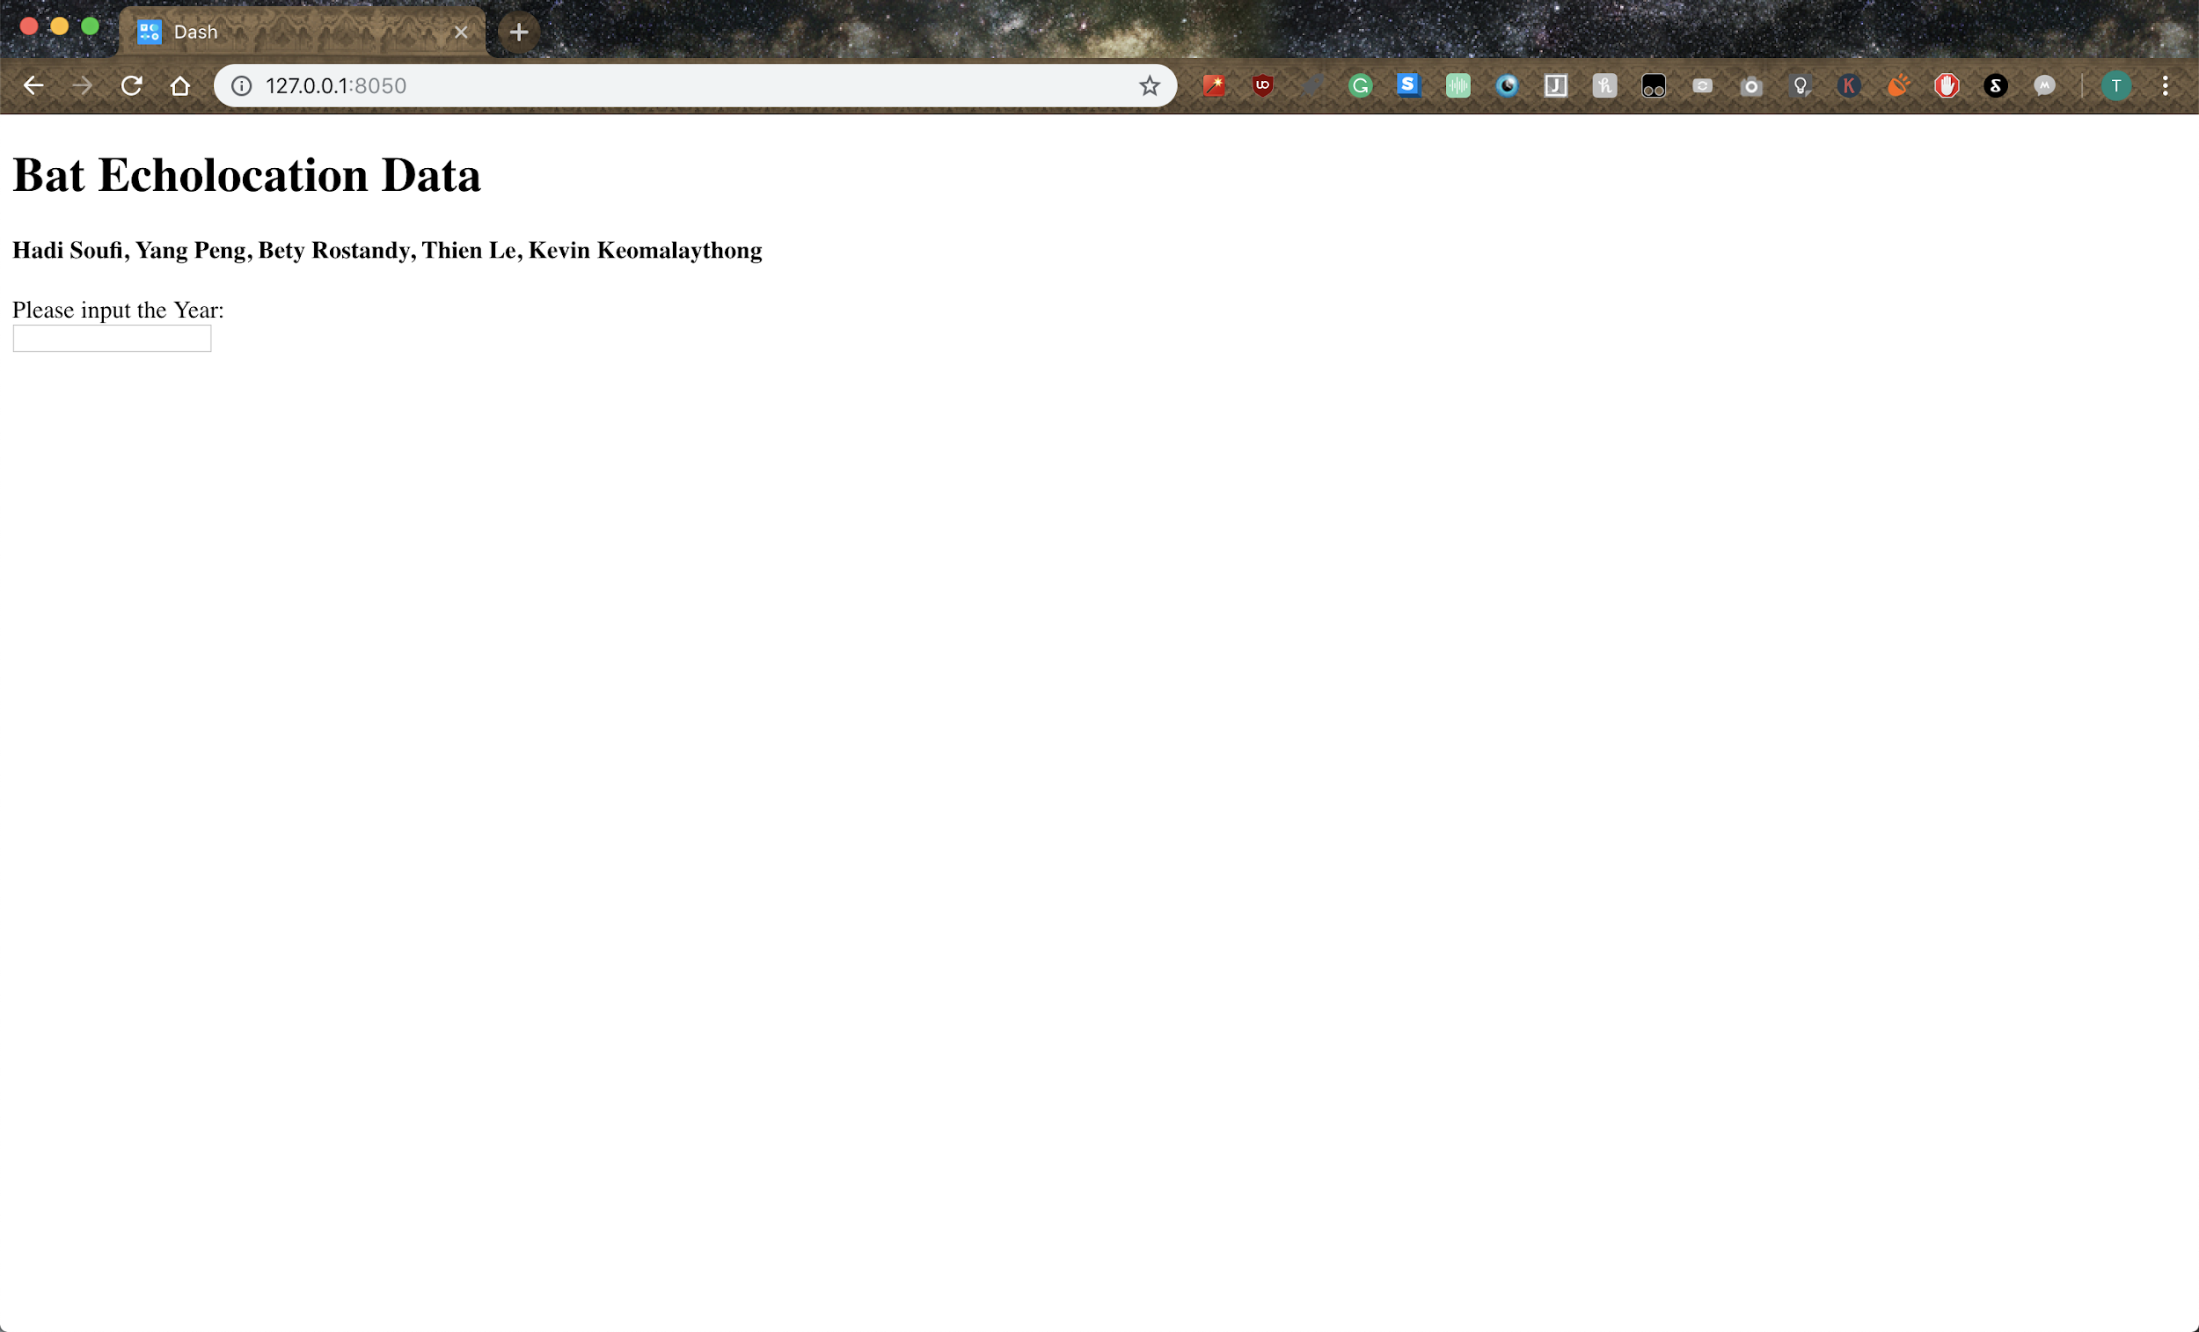
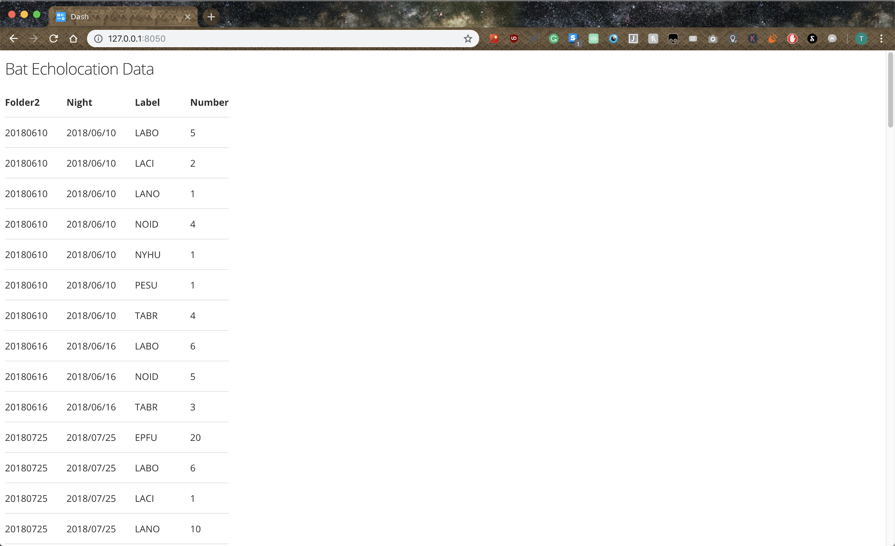
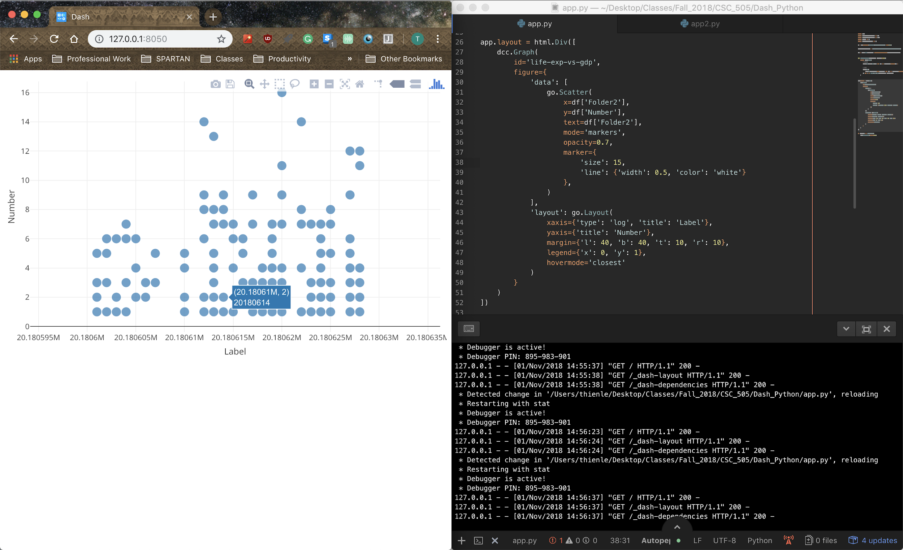
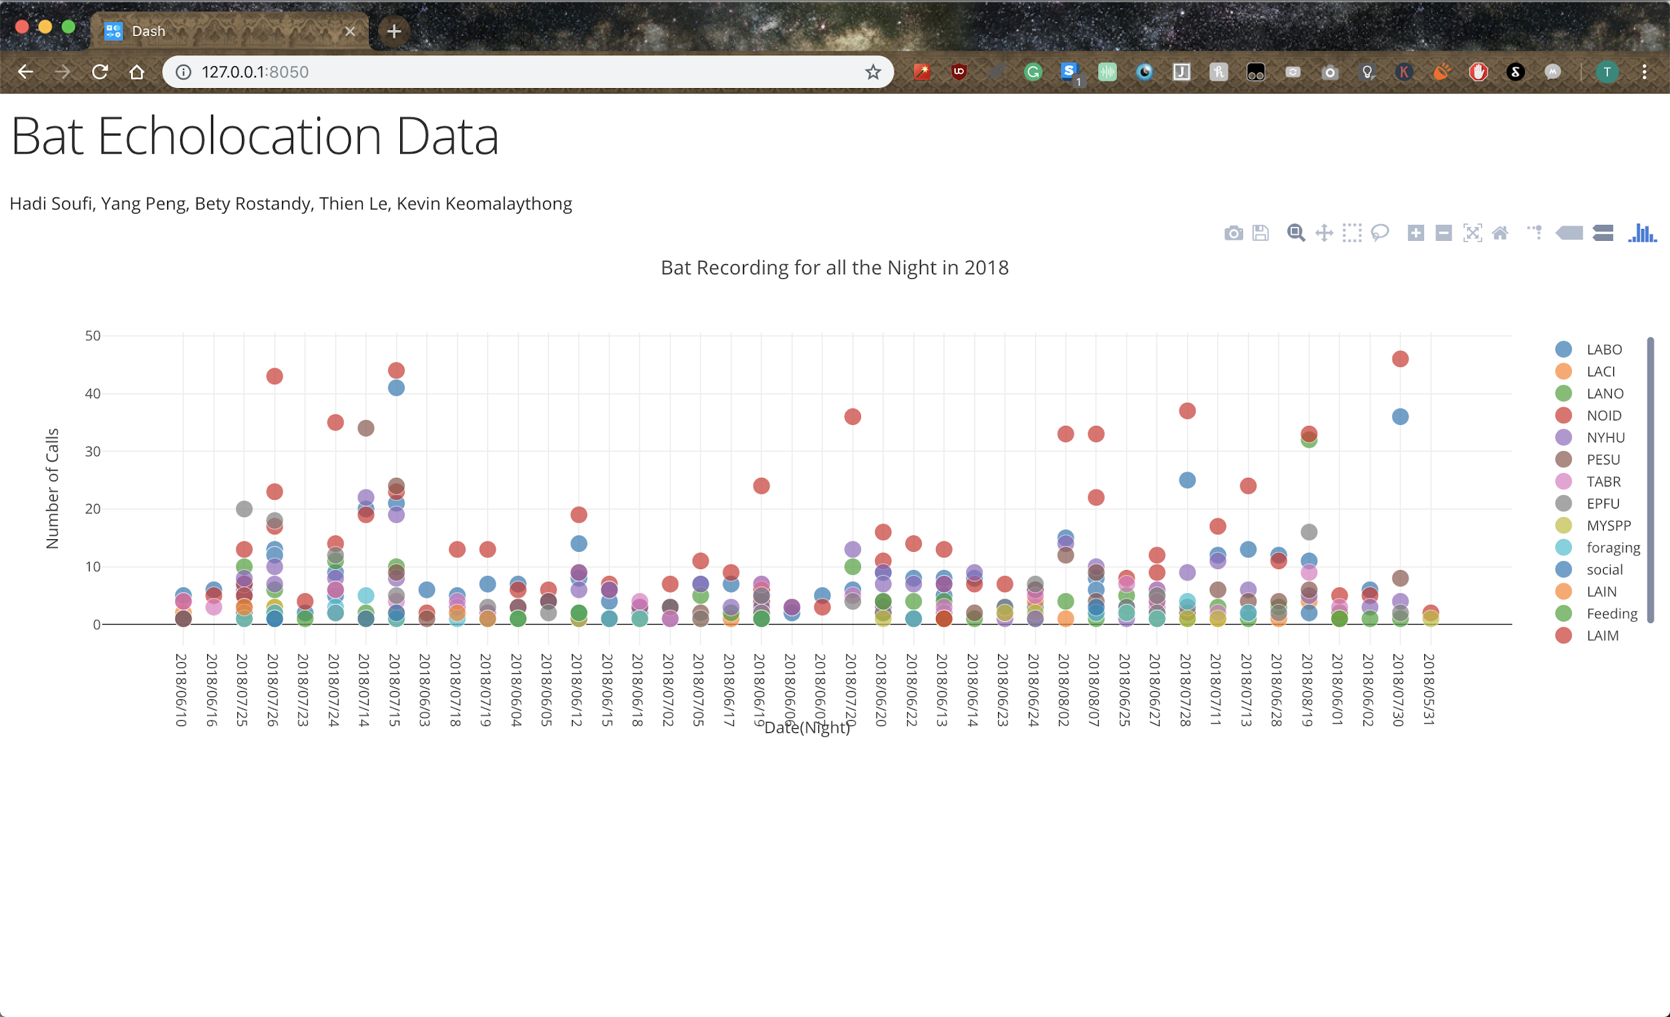
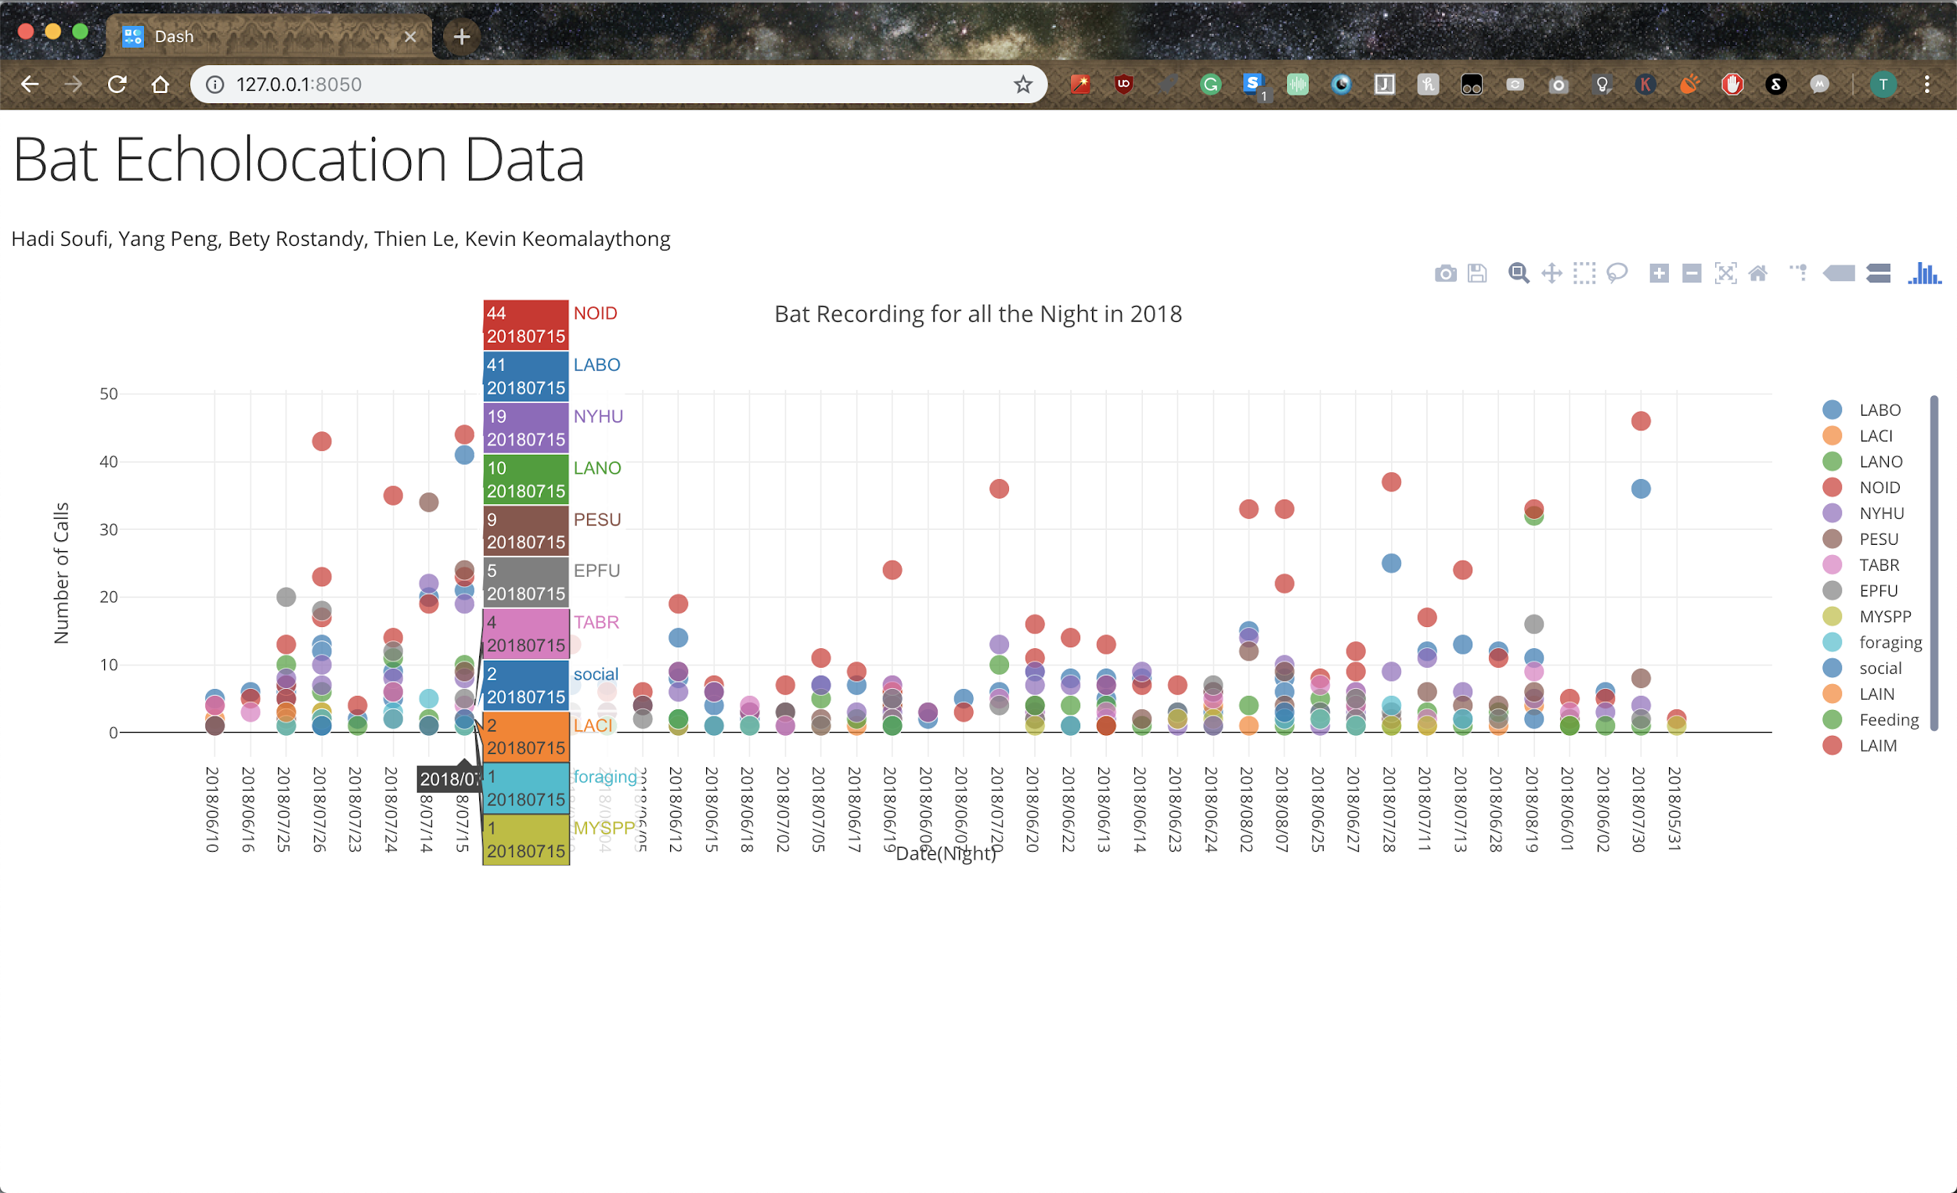
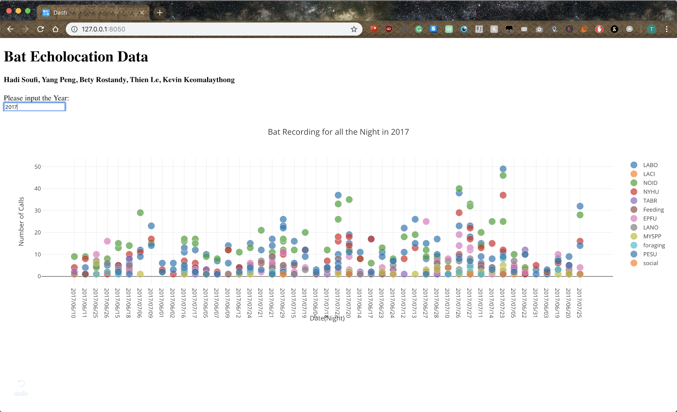
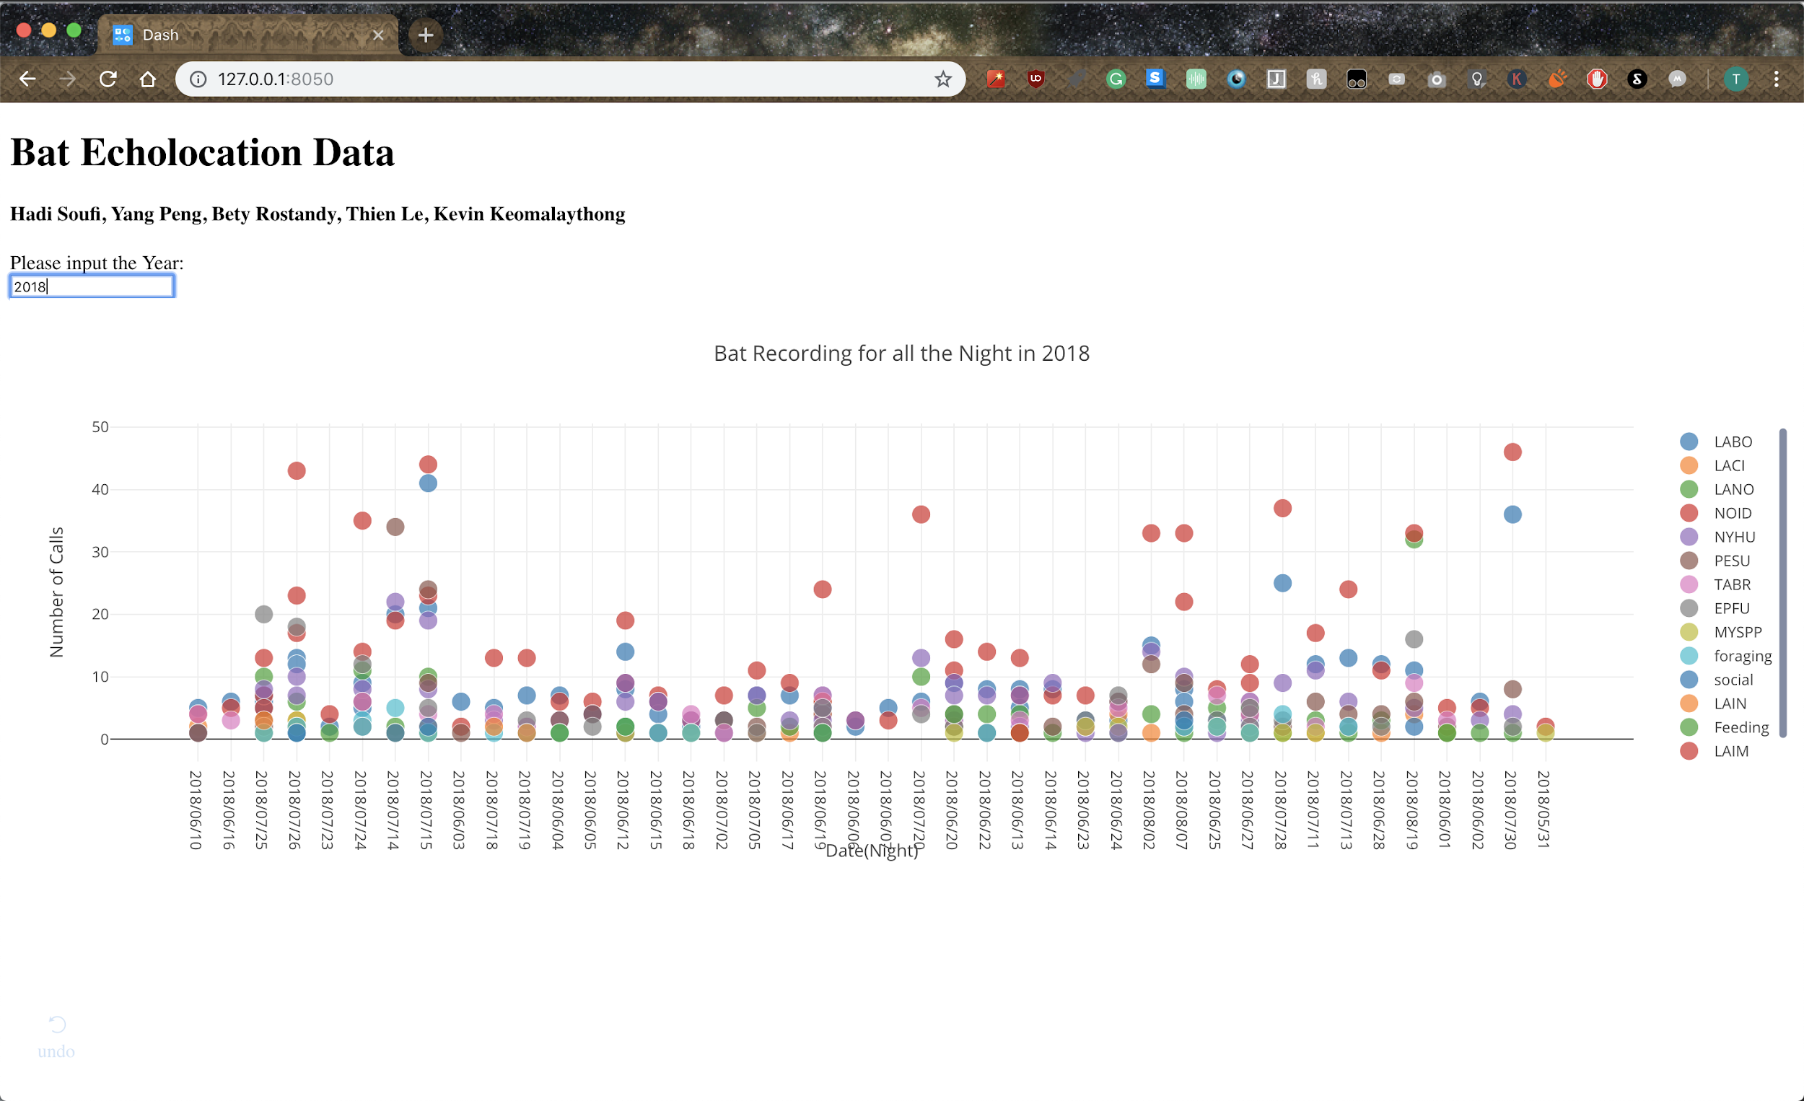
Platform Progress - Thien Le
Closer look at the labeled data for year 2018
Display the Graph based on user input -2015
Display the Graph based on user input -2016
Display the Graph based on user input
Display the Graph based on user input -2017
Display the Graph based on user input -2018
Load the .csv file into the website
Table to Interactive chart
categorized the data
Interact with the data
Eptesicus fuscus (EPFU) Lasiurus borealis (LABO)
Lasiurus cinereus (LACI), Lasionycteris noctivagans (LANO),
Nycticeius humeralis (NYHU), Myotis spp. (MYspp),
Perimyotis subflavus (PESU), Tadarida brasiliensis (TABR).
Bat calls that were not able to be identified to species are labeled NOID

Slide 10
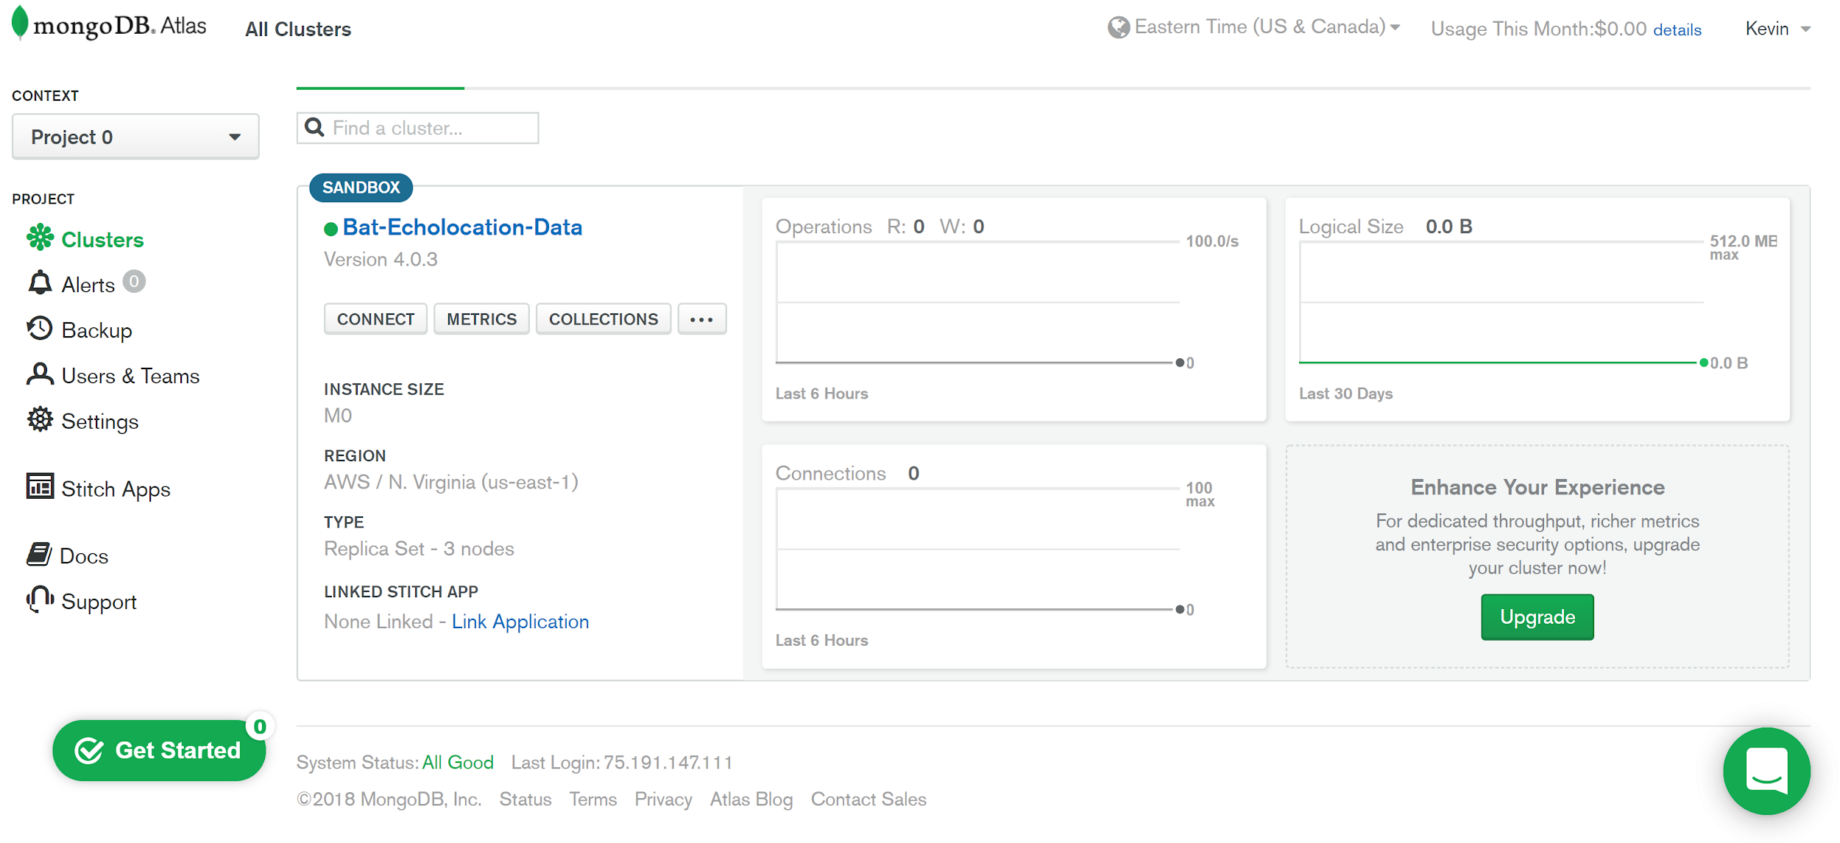
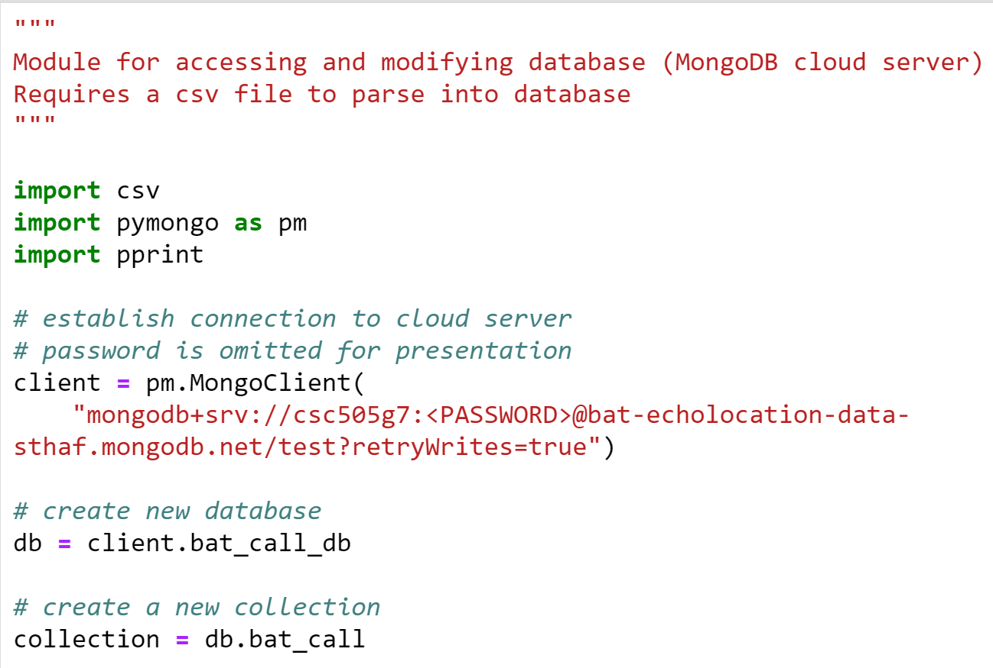
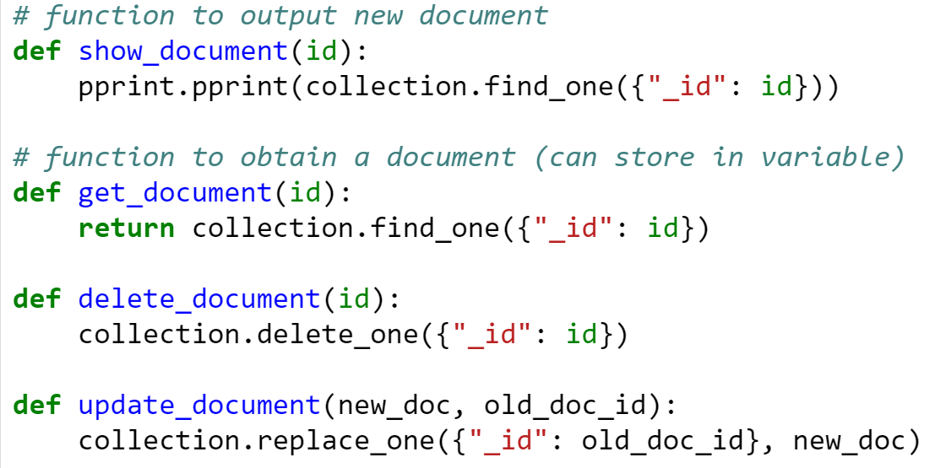
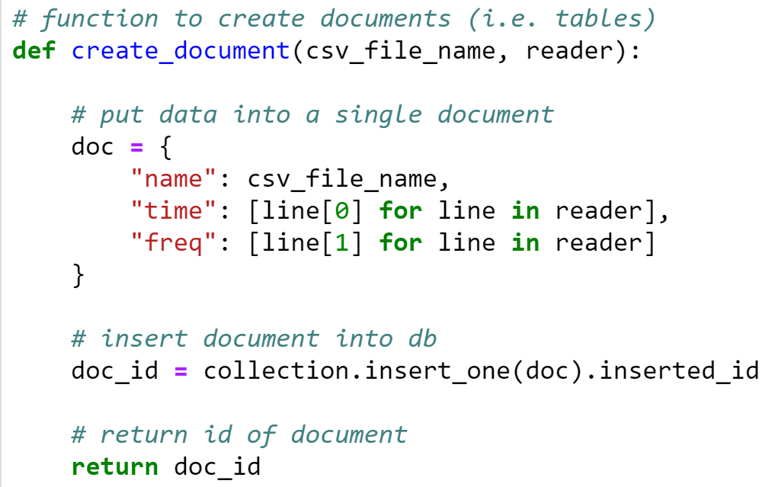
Database Implementation Progress - Kevin
Notes:
Issue: Jupyter cannot connect to cloud server with MongoClient(); currently contacting support

Slide 11
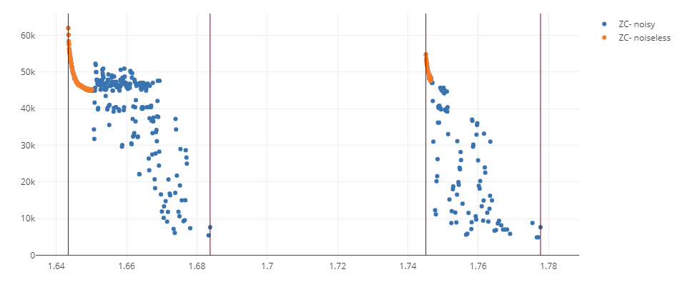
Noise removal
Notes:
This is a sample of my algorithms results so far. As you can see its very effective, only ignoring 4 or 5 points that are considered good data. It works by chunking a file into pulses, generating a smoothed graph of each pulse, and removing parts of the pulse that are too different from the smooth graph.

Slide 12
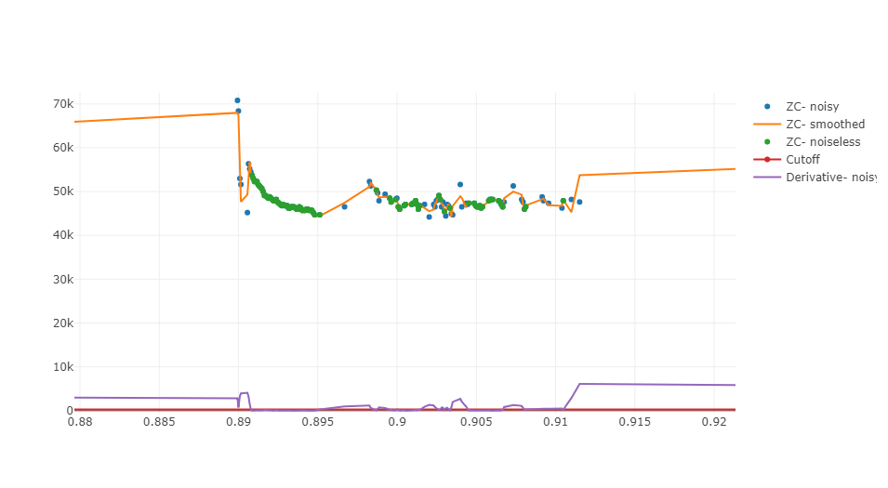
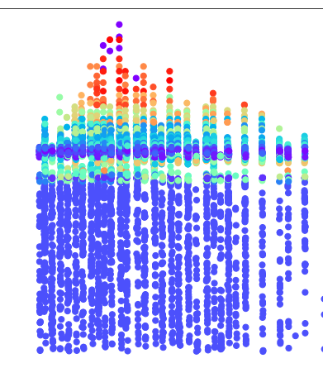
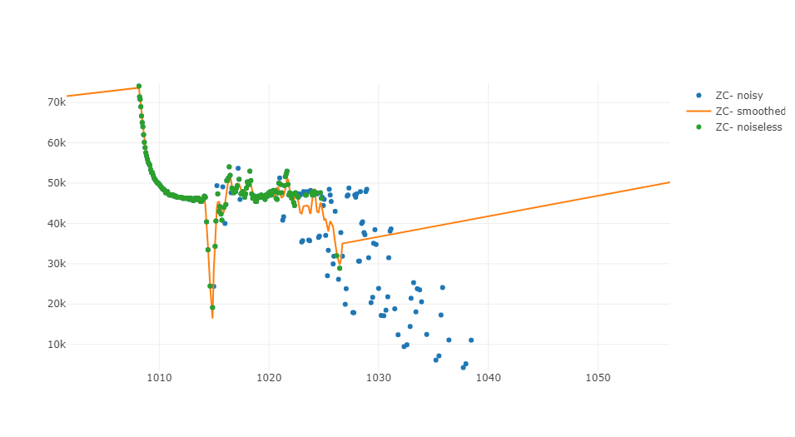
Methods
2nd Derivative analysis
DBSCAN
Graph shape analysis

Slide 13
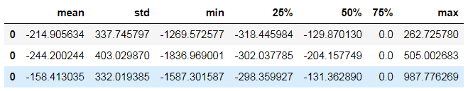
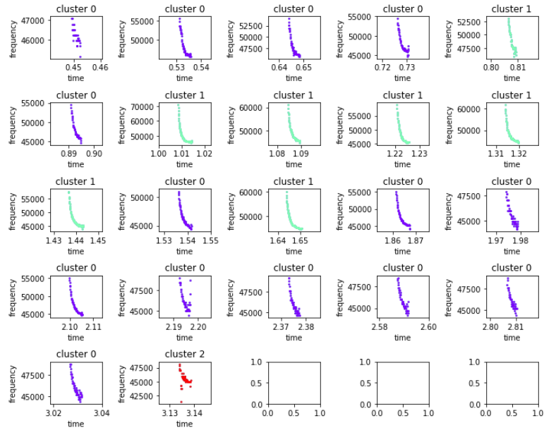
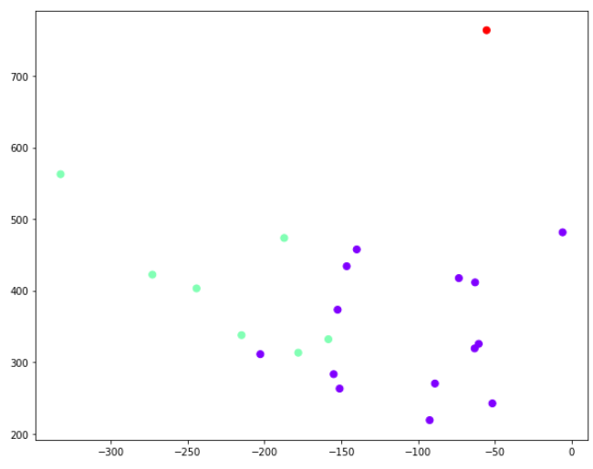
Clustering Progress - Yang P
Features:
Use mean, sd and
five number summary of dy
Notes:
librosa data visualization package
Task by Member
Progress made towards the task.
If background research - describe it.
If coding - show outcomes.

Slide 14
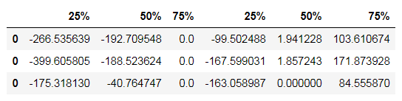
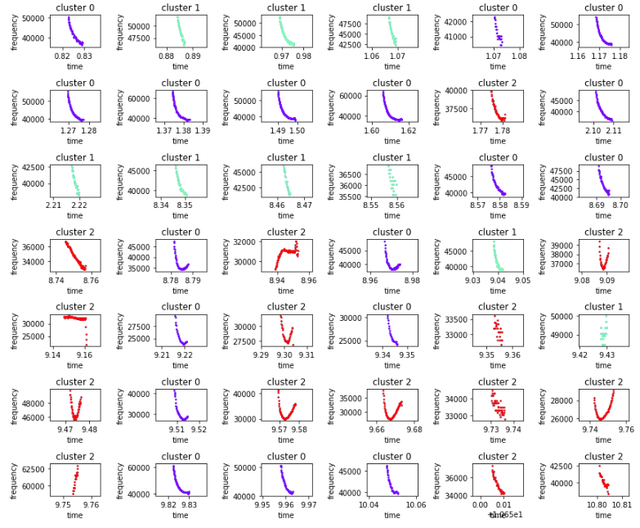
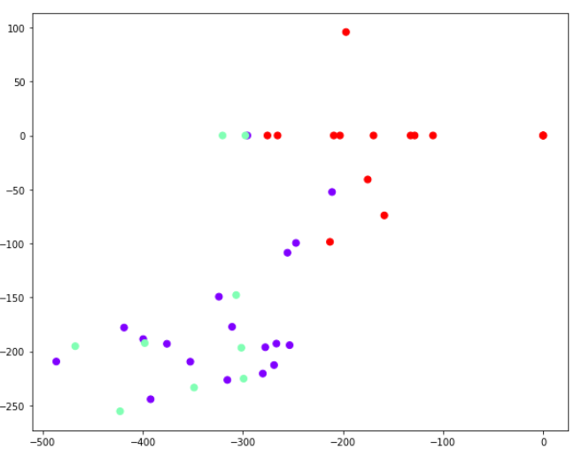
Clustering Progress - Yang P
In order to detect the curvature and get a more robust clustering results, use the resistant features --- Q1 Median Q3 of dy and dy2
Notes:
librosa data visualization package
Task by Member
Progress made towards the task.
If background research - describe it.
If coding - show outcomes.

Slide 15
Next steps:
Complete noise removal
Have a live database and website that can talk to each other
Further statistical analysis

Slide 16
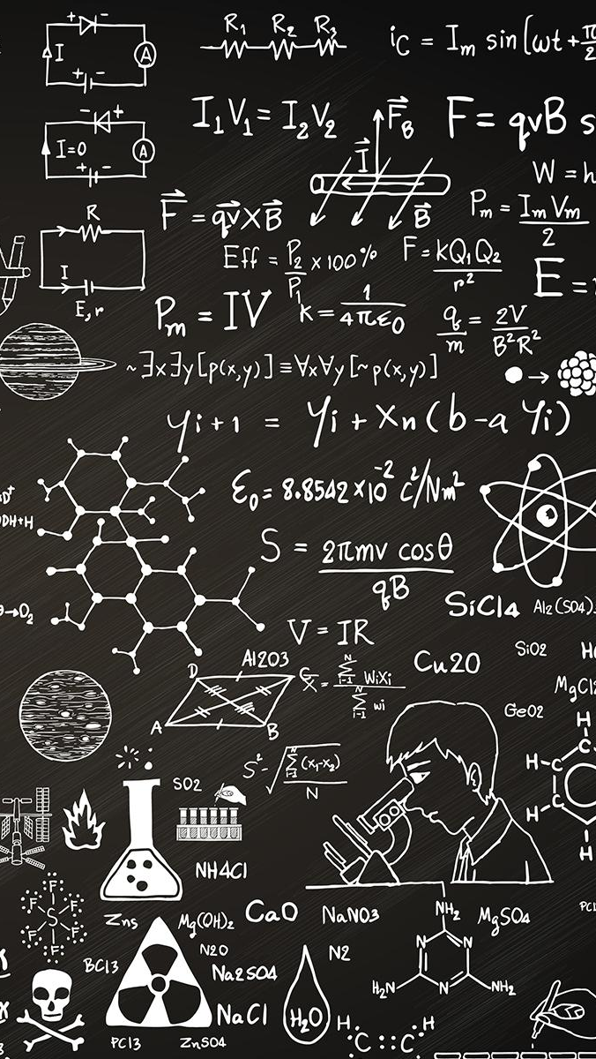
THANKS!
Any questions?

